Slide 1
State Reporting Supplier Validation Guide— Contracting with Louisiana HCP-Public Servants

Slide 2
Purpose
3rd Party value transfers—
Textbooks
Program/Event Attendees
Contracted Consultants/Speakers
—represent the greatest area of compliance risk in our business relationships with LA HCP-Public Servants.
This validation guide is intended to minimize that risk by instituting a step-by-step process for Suppliers to identify possible LA Public Servants.

Slide 3
Policy Reference Sources
Prior to any contract with/payment to any HCP, every Supplier is required to conduct an EPLS & FDA Debarment List check in accordance with their respective Master Services Agreement (MSA).
Additionally, there exists contractual language within the MSA, as well as follow-on provisos in Work Orders (WOs) and Statements of Work (SOWs), that supports the inclusion of the LA Validation Guide as a required check—
Ex. “Written evidence of any required ethics or other authorizations allowing HCPs employed by federal, state or local government agencies, including but not limited to pharmacy and therapeutics committees, to provide consulting services under this Agreement.”
Ex. “Understand and execute all J&J Health Care Compliance (HCC) requirements…Ensure conclusive program data is collected to facilitate adherence to state laws and to provide accurate/conclusive state reporting documentation.”

Slide 4
LA Public Servant Overview
Who is a Public Servant?
Government Employee (State, Parish, Local)
Elected Official in Public Office
Member of State Advisory Board/Committee
Employee of State-Run Hospital
Employee of Public University (LSU)
Including employment status as --
Full-time, Part-time, or Internship
Restrictions on Public Servants?
Food/Drink | LIMITED ($50/event)
Textbooks | PROHIBITED
Speakers | PROHIBITED
Consultants | ALLOWED
No maximum annual limit on occurrences

Slide 5
LA Public Servant Overview
(Former) Charity Hospital | Address | City | Status | Transition Date | Notes
Bogalusa Medical Center | 433 Plaza St. | Bogalusa | Public-Private | 3/17/2014 | Now known as Our Lady of the Angels Hospital, administered by Franciscan Missionaries of Our Lady Health System
E.A. Conway Medical Center | 4864 Jackson St. | Monroe | Public-Private | 10/1/2013 | Now known as University Health Conway, administered by University Health System
Earl K. Long Medical Center | 5825 Airline Hwy. | Baton Rouge | Closed | 4/22/2013 | Former clinics of EKLMC are now managed by LSU Health Baton Rouge, a division of Our Lady of the Lake
Huey P. Long Medical Center | 352 Hospital Blvd. | Pineville | Closed | 6/30/2014
Lallie Kemp Regional Medical Center | 52579 Hwy. 51 S | Independence | Public | N/A | Remains under public purview
Leonard J. Chabert Medical Center | 1978 Industrial Blvd. | Houma | Public-Private | 6/24/2013 | Administered by Ochsner Health System
University Hospital | 1501 Kings Hwy. | Shreveport | Public-Private | 10/1/2013 | Now known as University Health Shreveport, administered by University Health System
University Hospital (Interim LSU Public Hospital) of MCLNO | 2021 Perdido St. | New Orleans | Public-Private | 6/24/2013 | Administered by Louisiana Children’s Medical Center
University Medical Center | 2390 W Congress St. | Lafayette | Public-Private | 6/24/2013 | Administered by Lafayette General Health System
W.O. Moss Regional Medical Center | 1000 Walters St. | Lake Charles | Public-Private | 6/24/2013 | Administered by Lake Charles Memorial Health System
Johnson & Johnson PGHCC Position—
Employees of former charity hospitals, which are now administered via public-private partnerships, will continue to be considered LA Public Servants and remain subject to the applicable compliance restrictions.
Johnson & Johnson PGHCC Position—
Employees of former charity hospitals, which are now administered via public-private partnerships, will continue to be considered LA Public Servants and remain subject to the applicable compliance restrictions.

Slide 6
Validation Resources
Louisiana State University Health Sciences Center (LSUHSC) Employee Directory—
Searchable, publicly available database: https://www.lsuhsc.edu/directory/
AND
LA Compliance Audit Excel Search Tool—
Searchable, company-internal database: http://www.totalitygatewayresources.com/sites/default/files/LA%20Compliance%20Audit%20Excel%20Search%20Tool_1.xlsx

Slide 7
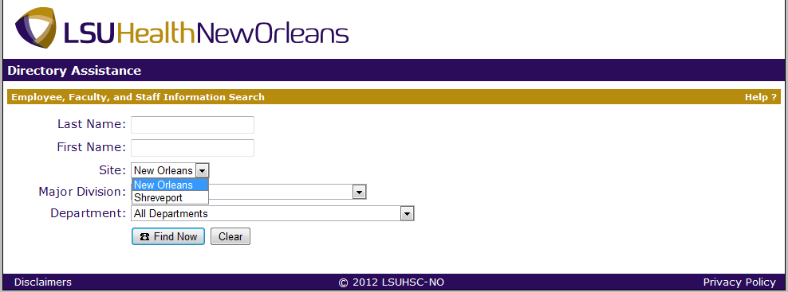
LSUHSC Employee Directory
1. In your web browser, go to https://www.lsuhsc.edu/directory/.
2. Enter the HCP’s last and/or first name, or beginning letters of either.
3. Select and search both Site options for the HCP.
4. Click on Find Now. If there are matches against the HCP data you entered, the record(s) will display below.

Slide 8
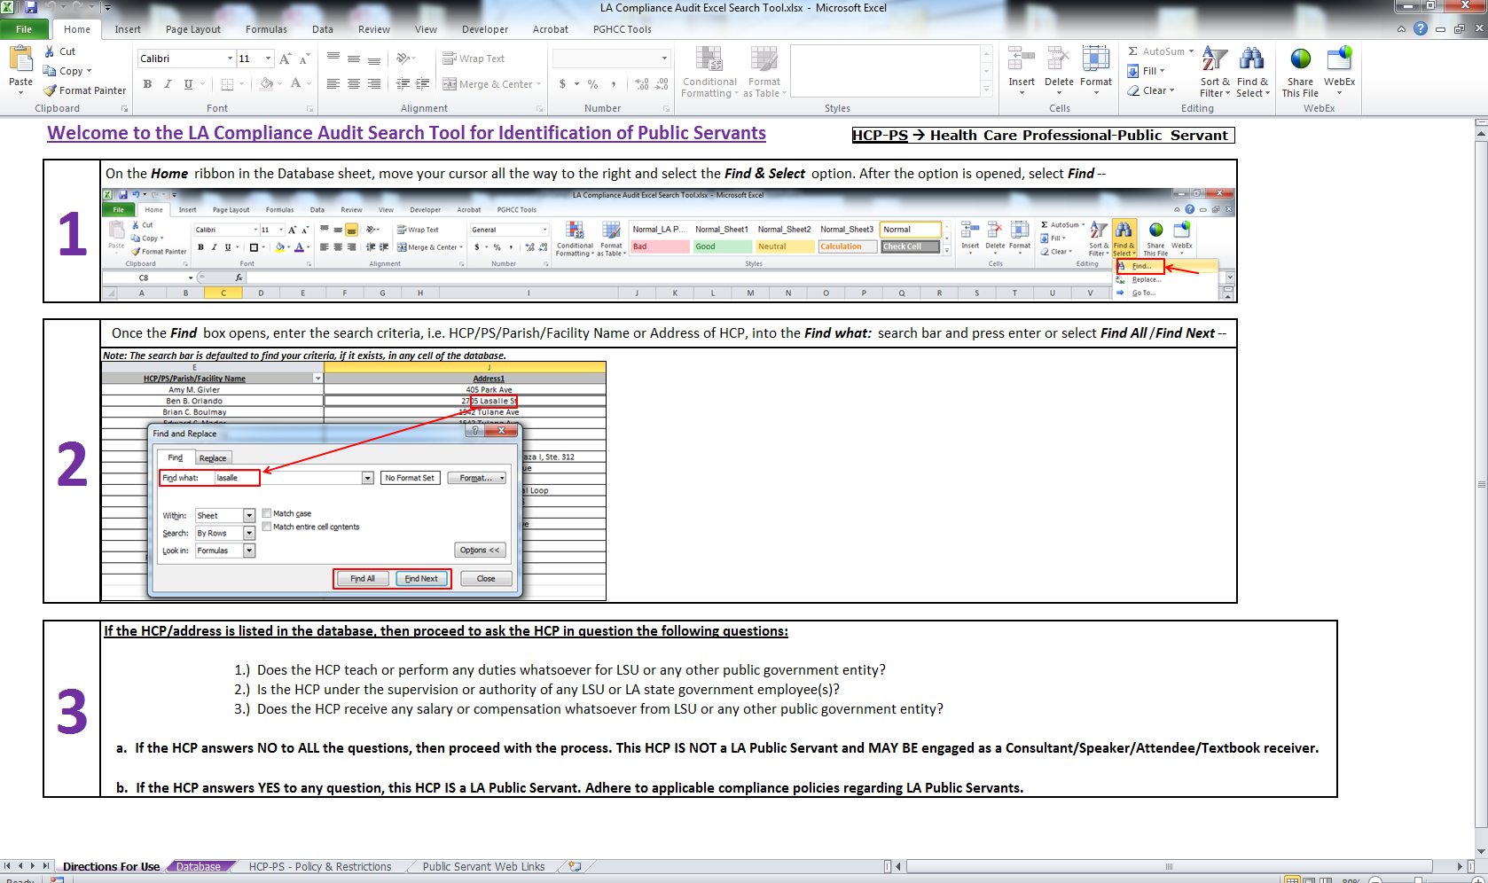
LA Compliance Audit Excel Search Tool
Located on Totality Training Guidance & Resources homepage — http://totalityportal.jnj.com/Pages/Training%20Guidance%20and%20Resources.aspx

Slide 9
Validation Process Steps
Conduct LSUHSC Employee Directory Check by HCP Name—
If the HCP IS NOT listed in the directory, then proceed to Step 2.
If HCP IS listed in the directory, then proceed to Step 3.
Conduct LA Compliance Audit Report Database Check by HCP Name/Address—
If the HCP IS NOT listed in the database tables, then the HCP IS NOT a LA Public Servant. Proceed with the contract process. This HCP MAY BE engaged as a consultant or speaker.
If the HCP IS listed in the database tables, then proceed to Step 3.
Have the HCP attest to the 3 Questions (from Legal)—
Does the HCP teach or perform any duties whatsoever for LSU or any other public government entity?
Is the HCP under the supervision or authority of any LSU or LA state government employee(s)?
Does the HCP receive any salary or compensation whatsoever from LSU or any other public government entity?
If the HCP answers NO to ALL the questions, then proceed with the contract process. This HCP IS NOT a LA Public Servant and MAY BE engaged as a consultant or speaker.*
If the HCP answers YES to any question, then PAUSE the contract process. This HCP IS a LA Public Servant. Proceed to Step 4a or 4b.
4a) Speaker Contract ONLY (Speaker Training, Promotional Speaker Programs, etc.)—
If the LA HCP-PS is being contracted as a Speaker, then STOP the contract process. This LA HCP-PS may NOT be engaged as a Speaker, as this is strictly PROHIBITED by LA law. END.
4b) Consulting Contract ONLY (Advisory Board, General Consulting, Sales Force Training, Spokesperson/Media Training, CME activities, etc.)—
Confirm that the LA HCP-PS possesses—
The applicable subject-matter expertise; AND
Written permission to serve as a consultant from his/her supervisor at the respective public organization.
If the LA HCP-PS confirms BOTH of the above stipulations, then proceed with the contract process. This LA HCP-PS MAY BE engaged as a consultant. END.
If the LA HCP-PS CANNOT confirm BOTH of the above stipulations, then STOP the contract process. This LA HCP-PS MAY NOT be engaged as a consultant. END.
*Records of correspondence with the HCP confirming non-Public Servant status should be documented and included on any value transfer uploads associated with the contract.

Slide 10
PGHCC Contact Information
If you encounter any issues or problems, you can contact the list below, according to category, for resolution or troubleshooting—
General Support: PGHCC Support Mailbox (RA-PRDUS-PGHCC_Suppo@ITS.JNJ.com)
Totality Process: Amtul Sufi (Asufi@its.jnj.com)
Totality Technical Issues: GASD@conbj.jnj.com
LA Policy & Validation Process: Sean Cavanaugh (SCavana1@ITS.JNJ.com)

